Slide 1
Binary Search
BY
Yekolla Manoj

Slide 2
Important Points
Binary Search is some another names are there :
binary chop , half interval , logarithmic.
It is a search Alogirthm.
It is used to find the position of an element in a sorted array.

Slide 3
Alogirthm
Step 1 : Find the middle element array.
middle= (initial value + end value) /2
Step 2 : middle =element then returns element found , otherwise
Step 3 : middle > element then call the function ( u=m-1 )
u=upper element , m=middle element
Step 4 : middle < element then call the function (l=m+1)
l=lower element ,m=middle element

Slide 4
Code
        using System;
        namespace Binary_Search_2
        {
        class Program
        {
        static void Main(string[] args)
        {
        // Create an array of 10 elements
        int[] IntArray = new int[10] { 9,30,6,44,12,36,89,38,11,66};
        // Value to search for
        int target = 36;

Slide 5
Code-cont
int pos = Array.BinarySearch(IntArray, target);
if (pos >= 0)
Console.WriteLine($"Item {IntArray[pos].ToString()} found at position {pos + 1}.");
else
Console.WriteLine("Item not found");
Console.ReadLine();
}
}
}

Slide 6
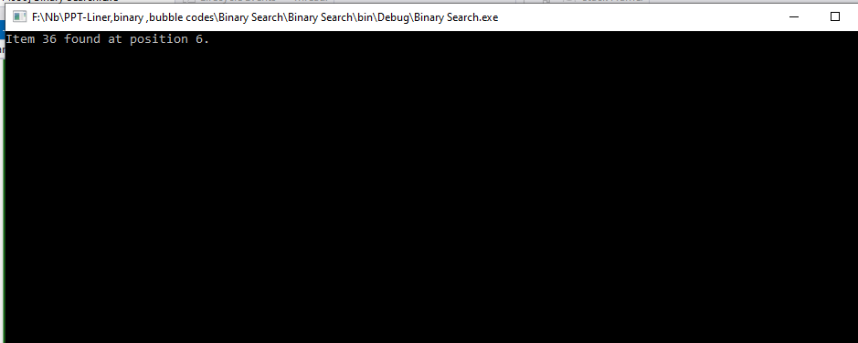
output

Slide 7
Thank You

